Slide 1

SAS Code for
STATUS REPORT
Pei Yuanyuan
Apr 15, 2022

Slide 2
C O N T E N T S
1
REQUEST
VALIDATION
3
Output Study Status Report
Delivery and Echo
2
DEVELOPMENT
INTROSPECTION
4
Decompose Request
What to Improve

Slide 3
01
WHAT IS THE REQUEST?
REQUEST
DEVELOPMENT
VALIDATION
INTROSPECTION

Slide 4
Study Status Report including...
1. Subject Status: in Summary and in Detail
2. Missing Page Status: Not Entered Pages (for CRC)
3. SDV Status: Not SDVed Pages (for CRA)
4. Query Status: Open/Answered/Closed Queries, in Summary and Detail (for CRC/CRA/DM/MM/Coder…)
5. AE Listing: especially SAE
6. DM Working Status Tracking: What for Next Time
7. Other Status: e.g. User List
REQUEST
DEVELOPMENT
VALIDATION
INTROSPECTION

Slide 5
02
HOW TO DECOMPOSE THE REQUEST?
REQUEST
DEVELOPMENT
VALIDATION
INTROSPECTION

Slide 6
Logic:
1. Gain Needed Data
2. Product Per Report
3. Output Reports as .xlsx
4. Organize Above Programs
REQUEST
DEVELOPMENT
VALIDATION
INTROSPECTION

Slide 7
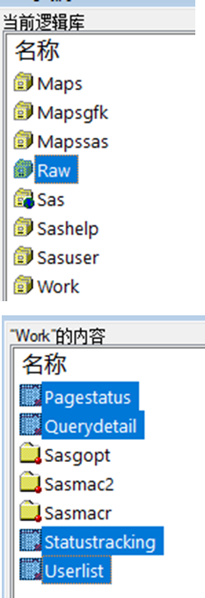
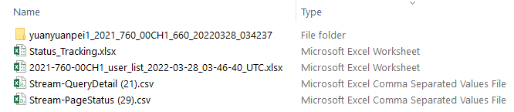
1. Gain All Needed Data
What report does DM want | Where is the source (Rave)
Subject Status in Detail | Raw datasets
Missing Page Status | Stream-Page Status, Subject Status in Detail
(Not) SDV Status | Stream-Page Status, Subject Status in Detail
Query Status: Open/Answered/Closed | Stream-Query Detail, Subject Status in Detail
Subject Status in Summary | All above
AE Status: especially SAE | Raw datasets
DM Working Status Tracking | DM provided
Other Status: e.g. User List | Study user list
libname raw “…";
proc import …
dbms=xlsx
proc import
dbms=xlsx
delimiter=‘09’x
REQUEST
DEVELOPMENT
VALIDATION
INTROSPECTION

Slide 8
2. Product Reports by Programming the Data
What report does DM want | Where is the source (Rave)
Subject Status in Detail | Raw datasets
Missing Page Status | Stream-Page Status, Subject Status in Detail
(Not) SDV Status | Stream-Page Status, Subject Status in Detail
Query Status: Open/Answered/Closed | Stream-Query Detail, Subject Status in Detail
Subject Status in Summary | All above
AE Status: especially SAE | Raw datasets
DM Working Status Tracking | DM provided
Other Status: e.g. User List | Study user list
1
2
3
4
REQUEST
DEVELOPMENT
VALIDATION
INTROSPECTION

Slide 9

2.1 Subject Status in Detail: raw datasets
What to display
Is which field
From what form
Of what folder
With what logic
Site name | SiteNumber | Subject name or identifier | Enroll_or_not? | Dose_Phase | Plan_Dose_or_Cohort | ICF_Date | Initial Tumor Type | DLT Evaluable Patients? | Any_DLT_Event?(Y N) | First_Dose_Date | Last_Dose_Date | Latest_Visit | Latest_Visit_Date | EOT_Date | Latest_OS_Date | EOS_Date
Ruijin Hospital Affiliated to Medical College of Shanghai Jiaotong University | 01 | 01001 | Yes | Dose Escalation | 50mg | 28/Dec/2021 | Chronic Lymphocytic Leukemia/Small Lymphocytic Lymphoma (CLL/SLL) | Yes |  | 4/Jan/2022 | 16/Feb/2022 | Cycle 2 Day 15 | 16/Feb/2022
Ruijin Hospital Affiliated to Medical College of Shanghai Jiaotong University | 01 | 01002 | No |  |  | 8/Feb/2022 |  |  |  |  |  | Screening | 8/Feb/2022
Union hospital tongji medical college huazhong university of science and technology | 03 | 03001 | Yes | Dose Escalation | 50mg | 14/FEB/2022 |  |  |  |  |  | Cycle 1 Day 15 | 18/MAR/2022
贴上模版里的表格，用以举例
REQUEST
DEVELOPMENT
VALIDATION
INTROSPECTION

Slide 10
2.2 Missing page Status: page status, subject detail
（1）. Common missing pages
From subject status detail
From page status
Merge by
Customized planned info
Program Judged
Site name | Site Number | SubjectID | Subject Status | ICF_Date | C1D1_Visit_Date | Dose_Phase | Planned_Folder_Name | Planned_Min_Visit_Date | Planned_Max_Visit_Date | Actual_Visit_Date | EOT_Date | Missing_Page_Name | Misiing_Visit(YN) | Current_Date | Entry_Delay_Aging
Ruijin Hospital Affiliated to Medical College of Shanghai Jiaotong University | 01 | 01001 | Enrolled | 28/Dec/2021 | 7/Jan/2022 | Dose Escalation | Cycle 3 Day 1 | 01-Mar-2022 | 07-Mar-2022 |  |  |  | Y | 28-Mar-2022 | 21
Union hospital tongji medical college huazhong university of science and technology | 03 | 03001 | Enrolled | 14/FEB/2022 | 5/MAR/2022 | Dose Escalation | Screening | . | . | 14/FEB/2022 |  | Diagnosis of Lymphoma | N | 28-Mar-2022 | 42
REQUEST
DEVELOPMENT
VALIDATION
INTROSPECTION

Slide 11
2.2 Missing page Status: page status subject detail
（2）. Tumor Assessment missing pages
From subject status detail
From page status
Merge by
Customized planned info
Program Judged
Site name | Site Number | SubjectID | Subject Status | C1D1_Visit_Date | EOT_Date | Dose_Phase | Planned_TA_Week | Planned_Min_TA_Date | Planned_Max_TA_Date | Actual_TA_Date | Missing_Page_Name | Missing week or not | Current_Date | Entry_Delay_Aging
Ruijin Hospital Affiliated to Medical College of Shanghai Jiaotong University | 01 | 01001 | Enrolled | 28/Dec/2021 | 7/Jan/2022 | Dose Escalation | Cycle 3 Day 1 | 01-Mar-2022 | 07-Mar-2022 |  |  | Y | 28-Mar-2022 | 21
Union hospital tongji medical college huazhong university of science and technology | 03 | 03001 | Enrolled | 14/FEB/2022 | 5/MAR/2022 | Dose Escalation | Screening | . | . | 14/FEB/2022 | Diagnosis of Lymphoma | N | 28-Mar-2022 | 42
REQUEST
DEVELOPMENT
VALIDATION
INTROSPECTION

Slide 12
2.2 Missing page Status: page status subject detail
data pweek11;
infile datalines ;
input code 2. pweek $24.;
datalines;
1 Tumor Assessment Week8
2 Tumor Assessment Week16
3 Tumor Assessment Week24
4 Tumor Assessment Week36
5 Tumor Assessment Week48
6 Tumor Assessment Week60
7 Tumor Assessment Week72
;
run;
data pform9;
infile datalines;
input pform $59.;
datalines;
Tumor Assessment Visit
Target Lesion Assessment
Non-Target Lesion Assessment
New Lesion Assessment
Spleen and Liver Assessment
PET-CT Evaluation
Overall Response Evaluation-Cheson 2014
Overall Response Evaluation-IWCLL2008
Overall Response Evaluation-IWWM-7
;
run;
proc sql;
create table plan as
select pweek11.*,pform9.* from pweek11,pform9;
Quit;
（2）. Tumor Assessment missing pages
Customized planned info
Site name | Site Number | SubjectID | Subject Status | C1D1_Visit_Date | EOT_Date | Dose_Phase | Planned_TA_Week | Planned_Min_TA_Date | Planned_Max_TA_Date | Actual_TA_Date | Missing_Page_Name | Missing week or not | Current_Date | Entry_Delay_Aging
Ruijin Hospital Affiliated to Medical College of Shanghai Jiaotong University | 01 | 01001 | Enrolled | 28/Dec/2021 | 7/Jan/2022 | Dose Escalation | Cycle 3 Day 1 | 01-Mar-2022 | 07-Mar-2022 |  |  |  | 28-Mar-2022 | 21
Union hospital tongji medical college huazhong university of science and technology | 03 | 03001 | Enrolled | 14/FEB/2022 | 5/MAR/2022 | Dose Escalation | Screening | . | . | 14/FEB/2022 | Diagnosis of Lymphoma |  | 28-Mar-2022 | 42
REQUEST
DEVELOPMENT
VALIDATION
INTROSPECTION

Slide 13
2.2 Missing page Status: page status
（3）. Summary of missing pages
Group by
Sum from Common Missing Page
Sum from TA Missing Page
Site name | Site Number | Of Subjects | of Missing Pages | Of EntryDelayAging(<5) | Of EntryDelayAging(5-10) | Of EntryDelayAging(>10) | Of Missing TumorAssessment Pages | Of TumorEntryDelayAging(<5) | Of tumorEntryDelayAging(5-10)
Ruijin Hospital Affiliated to Medical College of Shanghai Jiaotong University | 01 | 1 | 1 | 0 | 0 | 1 | 0 | 0 | 0
Union hospital tongji medical college huazhong university of science and technology | 03 | 1 | 1 | 0 | 0 | 1 | 0 | 0 | 0
 | Total | 2 | 2 | 0 | 0 | 2 | 0 | 0 | 0
proc sql;
*missing page总数;
create table ms3 as
select distinct site,sitenumber,count(distinct subject) as nsub,count(forcount) as nall
from mispg
group by sitenumber;
*插入total行;
insert into ms3 (site,sitenumber,nsub,nall)
select '' as site,'Total' as sitenumber,count(distinct subject) as nsub,count(forcount) as nall
from mispg;
quit;
REQUEST
DEVELOPMENT
VALIDATION
INTROSPECTION

Slide 14
2.2 SDV Status: page status, subject detail
From page status
From subject status detail
Merge by
Program Judged
SiteName | SiteNumber | Subject_ID | Folder_Name | Pages_Not_SDV | Visit_Date | SDV_Delay_Aging
Ruijin Hospital Affiliated to Medical College of Shanghai Jiaotong University | 01 | 01001 | Common Pages | Adverse Event |  | .
Ruijin Hospital Affiliated to Medical College of Shanghai Jiaotong University | 01 | 01001 | Common Pages | Prior and Concomitant Medication |  | .
Ruijin Hospital Affiliated to Medical College of Shanghai Jiaotong University | 01 | 01001 | Common Pages | Prior and Concomitant Procedure |  | .
Ruijin Hospital Affiliated to Medical College of Shanghai Jiaotong University | 01 | 01001 | Cycle 0 Day -3 | Weight | 4/Jan/2022 | 83
Ruijin Hospital Affiliated to Medical College of Shanghai Jiaotong University | 01 | 01001 | Cycle 1 Day 15 | Physical Examination_Brief | 20/Jan/2022 | 67
Ruijin Hospital Affiliated to Medical College of Shanghai Jiaotong University | 01 | 01001 | Cycle 1 Day 15 | Urinalysis | 20/Jan/2022 | 67
Ruijin Hospital Affiliated to Medical College of Shanghai Jiaotong University | 01 | 01001 | Cycle 1 Day 15 | Blood Chemistry | 20/Jan/2022 | 67
REQUEST
DEVELOPMENT
VALIDATION
INTROSPECTION

Slide 15
2.2 Query Status: query detail
(1). Open query listing:
From Query Detail
Open
Answered
Closed
Program Judged
SiteName | SiteNumber | subjectname | Folder | Form | Field | QryOpenDateLocalized | QryOpenBy | QueryText | MarkingGroupName | QryResponseDateLocalized | QryRespndBy | AnswerText | QryClosedDateLocalized | QryClosedBy | Name | Current_Date | Open_Query_Pending_Aging
Union hospital tongji medical college huazhong university of science and technology | 03 | 03001 | Common Pages | Drug Administration | EXADJ | 23Mar2022 | System | Data is required. Please complete. | To Site from System | . |  |  | . |  | Open | 28Mar2022 | 5
Union hospital tongji medical college huazhong university of science and technology | 03 | 03001 | Common Pages | Drug Administration | EXENDAT | 23Mar2022 | System | Data is required. Please complete. | To Site from System | . |  |  | . |  | Open | 28Mar2022 | 5
Union hospital tongji medical college huazhong university of science and technology | 03 | 03001 | PK Blood Collection | Pharmacokinetic Blood Sampling-Dose Escalation_C1D8 | PCSTTIM1 | 24Mar2022 | L.Lu | Please provide relevant AE record in AE page. | To Site from DM | . |  |  | . |  | Open | 28Mar2022 | 4
REQUEST
DEVELOPMENT
VALIDATION
INTROSPECTION

Slide 16
2.2 Query Status: query detail
(2). Answered query listing:
From Query Detail
Open
Answered
Closed
Program Judged
SiteName | StudyEnvironmentSiteNumber | subjectname | Folder | Form | Field | QryOpenDateLocalized | QryOpenBy | QueryText | MarkingGroupName | QryResponseDateLocalized | QryRespndBy | AnswerText | QryClosedDateLocalized | QryClosedBy | Name | Current_Date | Answered_Query_Pending_Aging
Ruijin Hospital Affiliated to Medical College of Shanghai Jiaotong University | 01 | 01001 | Cycle 1 Day 1 | 12-Lead ECG Twice | EGORRES | 16Feb2022 | j.cai | please check it is normal? | To Site from CRA | 18Feb2022 | 芹.王 | Sinus rhythm | . |  | Answered | 28Mar2022 | 38
Ruijin Hospital Affiliated to Medical College of Shanghai Jiaotong University | 01 | 01001 | Cycle 1 Day 15 | 12-Lead ECG | RR | 16Feb2022 | j.cai | 895? | To Site from CRA | 18Feb2022 | 芹.王 | Modified | . |  | Answered | 28Mar2022 | 38
Ruijin Hospital Affiliated to Medical College of Shanghai Jiaotong University | 01 | 01001 | Cycle 1 Day 15 | 12-Lead ECG | RR | 16Feb2022 | j.cai | 923? | To Site from CRA | 18Feb2022 | 芹.王 | what? | . |  | Answered | 28Mar2022 | 38
Ruijin Hospital Affiliated to Medical College of Shanghai Jiaotong University | 01 | 01001 | Cycle 1 Day 15 | Blood Chemistry | NA | 16Feb2022 | j.cai | 143? | To Site from CRA | 18Feb2022 | 芹.王 | Modified | . |  | Answered | 28Mar2022 | 38
REQUEST
DEVELOPMENT
VALIDATION
INTROSPECTION

Slide 17
2.2 Query Status: query detail
(3). Query summary:
Open
Answered
SiteName | Site_Number | #_of_Subjects | #_of_Open_Query | #_of_Open_Query_Pending_Aging(<5) | #_of_Open_Query_Pending_Aging(5-10) | #_of_Open_Query_Pending_Aging(>10) | #_of_Answered_Query | #_of_Answered_Query_Pending_Aging(<5) | #_of_Answered_Query_Pending_Aging(5-10) | #_of_Answered_Query_Pending_Aging(>10)
Ruijin Hospital Affiliated to Medical College of Shanghai Jiaotong University | 01 | 2 | 0 | 0 | 0 | 0 | 29 | 0 | 0 | 29
Union hospital tongji medical college huazhong university of science and technology | 03 | 1 | 17 | 10 | 3 | 4 | 0 | 0 | 0 | 0
 | Total | 3 | 17 | 10 | 3 | 4 | 29 | 0 | 0 | 29
REQUEST
DEVELOPMENT
VALIDATION
INTROSPECTION

Slide 18
2.3 Subject Status in Summary
From subject status detail
From page status
From query detail
Merge by
Site name | SiteNumber | #_of_Subjects | #_of_Subjects(Screening) | #_of_Subjects(Successfully_Enrolled) | #_of_Subjects(EOT) | #_of_Subjects(EOS) | #_of_Subjects(Screen_Failure) | #_of_Entered_Pages | #_of_Missing_Pages | Enter_Rate | #_of_Pages_Not_SDV | SDV_Rate | #_of_Open_Query | #_of_Answered_Query | #_of_Closed_Query | #_of_SAE
Ruijin Hospital Affiliated to Medical College of Shanghai Jiaotong University | 01 | 2 | 0 | 1 | 0 | 0 | 1 | 136 | 2 | 98.6% | 50 | 63.2% | 0 | 160 | 145 | 0
Union hospital tongji medical college huazhong university of science and technology | 03 | 1 | 0 | 1 | 0 | 0 | 0 | 86 | 4 | 95.6% | 86 | 0.0% | 17 | 39 | 43 | 0
 | Total | 3 | 0 | 2 | 0 | 0 | 1 | 222 | 6 | 97.4% | 136 | 38.7% | 17 | 199 | 188 | 0
REQUEST
DEVELOPMENT
VALIDATION
INTROSPECTION

Slide 19
2.3 Other Status:
AE Status: especially SAE | Raw datasets.sas7bdat
DM Working Status Tracking | DM provided.xlsx
Other Status: e.g. User List | Study user list.xlsx
REQUEST
DEVELOPMENT
VALIDATION
INTROSPECTION

Slide 20
3. Output Reports as .xlsx Files
Design output style:
ods excel options
(sheet_name=“SubjStatusTotal"
frozen_headers="on"
embedded_titles="yes"
hidden_rows='3');
REQUEST
DEVELOPMENT
VALIDATION
INTROSPECTION

Slide 21
4. Organize all programs
Get the root of current programs
%macro currentroot;
%global currentroot;
%let currentroot=%sysfunc(getoption(sysin));
%if "&currentroot" eq "" %then %do;
%let currentroot=%sysget(SAS_EXECFILEPATH);
%end;
%mend;
%currentroot;
Execute programs in order inside the root
REQUEST
DEVELOPMENT
VALIDATION
INTROSPECTION

Slide 22
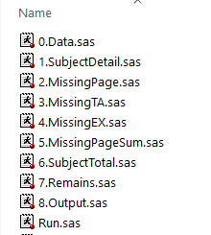
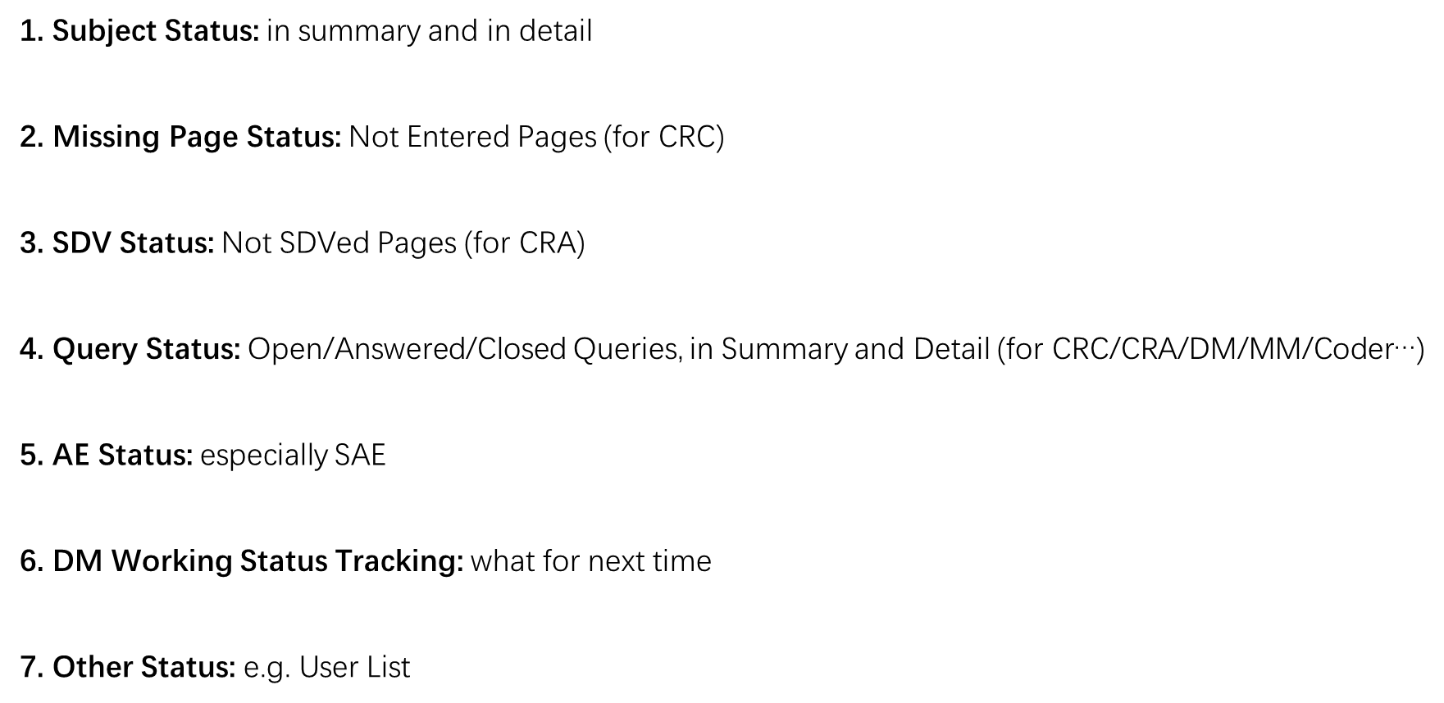
Conclusion of Development
The Programs Matched all the Request Templates.
Run.sas is the only need-to-run program.
REQUEST
DEVELOPMENT
VALIDATION
INTROSPECTION

Slide 23
03
IS IT REUSABLE?
REQUEST
DEVELOPMENT
VALIDATION
INTROSPECTION

Slide 24
What Can Be Transferred to Another Study
1. Gain Needed Data
libname raw “…";
proc import datafile="…“ out=&dname. dbms=xlsx replace; getnames=yes; run;
proc import datafile="…“ out=&dname. dbms=xlsx replace; getnames=yes; delimiter=‘09’x; run;
2. Product Per Report
*笛卡尔积;
proc sql; create table plan as
select pweek11.*,pform9.* from pweek11,pform9; Quit;
*插入total行;
insert into ms3 (site,sitenumber,nsub,nall)
3. Output Reports as .xlsx
ods excel options
(sheet_name="&shtnm." frozen_headers="on" embedded_titles="yes” hidden_rows=‘3’);
4. Organize Above Programs
%currentroot;
%include “....“;
REQUEST
DEVELOPMENT
VALIDATION
INTROSPECTION

Slide 25
04
WHAT TO IMPROVE?
REQUEST
DEVELOPMENT
VALIDATION
INTROSPECTION

Slide 26
What was achieved
Output Patient Profile for Each Subject
Output Compared Files with Tracking Marks
Satisfy Real World Request
REQUEST
DEVELOPMENT
VALIDATION
INTROSPECTION

Slide 27
What to Improve
How to Execute WordBasic Macros in SAS?
To simplify program
How to Create an Interactive Interface?
To optimize program
How to Make Patient Profile Change Visualized?
To strengthen program
REQUEST
DEVELOPMENT
VALIDATION
INTROSPECTION

Slide 28
Q&A
THANK YOU

